Slide 1
Harlem Hospital Center
Impact of Missed Appointments on Hospital Finances and Quality of Care
By Furhan Babar and Mary Grace Boyd
Data Analytics – September 12, 2020

Slide 2
Introduction
Throughout the fiscal year 2019-2020, the missed appointments or “no-show” data has been recorded at Harlem Hospital Center. Analysis of the data and other variables recorded could potentially give us an insight as to how this information may impact financial sustainability and quality of care given to patients.
Understanding baseline information and trend analysis is a vital component when undergoing quality improvement projects that may impact the overall vision, mission, and strategic goals of the institution and the health system.
This data set and analysis may affect the NYC Health and Hospital’s strategic pillars (SP) which aligns with Harlem Hospital Centers long term goals for the growth and development of the institution. The specific strategic pillars involved are:
Improve quality of patient care and services (SP: Quality, Safety)
Increase revenue streams (SP: Financial Sustainability)
Notes:
Business Goal:
To be able to use this data to analyze trends in patients’ appointment no show data
To be able to use this data as baseline information when analyzing quality improvement projects related to quality of patient care and services provided in Harlem Hospital

Slide 3
Research Questions
What variables have an impact to the missed appointments or no-show rate? Example of data variables: Weather, holidays, geographical location, type of service, religion, language, special needs, appointment time, etc..
What is the financial impact of missed appointments or no-show rate to Harlem Hospital Center?
How do gender and age variables compare on missed appointments or no-show rate?
Notes:
During quality improvement projects, we need to understand the basic information from the variables in the data set available to us. We need to determine if there is any way we can decrease the missed appointments or no-show rate understanding that there are certain variables that we may not be able to alter but may affect decision making processes.

Slide 4


Data Sources
Initial raw data on missed or no-show appointments was acquired from EPIC Reporting Work Bench for Harlem Hospital Center
Weather data was acquired from National Oceanic and Atmospheric Administration’s (NOAA) National Centers for Environnemental Information (NCEI)
Notes:
Initial raw data on missed or no-show appointments was acquired from EPIC Reporting Work Bench for Harlem Hospital Center
Weather data was acquired from National Oceanic and Atmospheric Administration’s (NOAA) National Centers for Environnemental Information (NCEI)
Initial Data Set:
Data Variables: ‘mrn', 'dob', 'age', 'sex', 'phone', 'encounter_provider', 'visit_date', ‘'appt_time', 'month', 'day_of_the_week', 'holiday', 'weather_type', 'max_temp', 'mini_temp', 'avg_temp', 'departure', 'hdd', 'cdd', 'precipitation', 'new_snow', 'snow_depth', 'status', 'encounter_closed', 'dept', 'dept_id', 'Avg_payment', 'visit_type', 'visit_type_id', 'copay_paid', 'chkin_time', 'check_in-check out', 'encounter_diagnoses', 'next_appt', 'appt_type', 'patient_employer', 'employer_state', 'patient_state', 'time_with_provider', 'wait_time_for_provider', 'zip_code', 'pcp', 'reason_for_visit', 'roomed_time', 'employer_zip', 'attending_provider', 'service', 'language', 'religion', 'hosp_acct', 'special_needs'
Number of rows: 21226
Number of columns: 50
Final Data Set:
Data Variables: 'mrn', 'dob', 'age', 'sex', 'sex_id', 'phone', 'encounter_provider', 'visit_date', 'appt_time', 'month', 'year', 'day_of_the_week', 'holiday', 'weather_type', 'avg_temp', 'precipitation', 'new_snow', 'dept', 'dept_id', 'Avg_payment', 'visit_type', 'visit_type_id', 'encounter_diagnoses', 'appt_type', 'patient_employer', 'employer_state', 'patient_state', 'zip_code', 'pcp', 'reason_for_visit', 'employer_zip', 'attending_provider', 'service', 'language', 'religion', 'special_needs', 'value_count'
Number of rows: 21225
Number of columns: 37

Slide 5
Methodologies
MS Excel Spreadsheet (CSV)– raw data gathering and initial visualization
https://raw.githubusercontent.com/mgmboyd/DA-Capstone-Project/master/No%20Show%20-%20FY20%20FINAL%20DATA%20SET%20-%20FINAL%20CSV.csv
Python using Google Colab – data cleaning, data wrangling, and exploratory data analysis
https://colab.research.google.com/drive/1vuY1xL7i6lcFCHI0VOzsPBsz2RmCvQho#scrollTo=U-te62ktdiZ4&uniqifier=1
Tableau – data visualization using worksheets, dashboards, and storyboards
MS PowerPoint Presentation – presentation of final data
GitHub – data and file storage
https://github.com/mgmboyd/DA-Capstone-Project/tree/master/FINAL%20CAPSTONE%20PROJECT%20FILES
Notes:
All sensitive data was changed our deleted from the file
Initial data set was in .xlxs file which was converted to .csv file
CSV file was uploaded in Github for easy reference for Python analysis
Google Colab was used for python analysis
Python libraries used: pandas, numpys, matplotlib.pyplot, matplotlib inline, plotly.express, seaborn, sodapy
Data cleaning and wrangling was done using Excel and Python
Dropping unnecessary columns & empty rows
Adding columns for quantitative analysis
Analyzing average payments for insurances
Python visualization used: bar plots, scatterplots, histograms
Tableau was used to create dashboard and graphs for easy data visualization and presentation
PowerPoint presentation was used for presentation purposes
NEXT - We are going to show you baseline analysis of the data set and then the final analysis and conclusive findings using Python and Tableau

Slide 6
BASELINE ANALYSIS & FINDINGS using Python
Notes:
We are going to show you baseline analysis of the data set and then the final analysis and conclusive findings using Python and Tableau

Slide 7
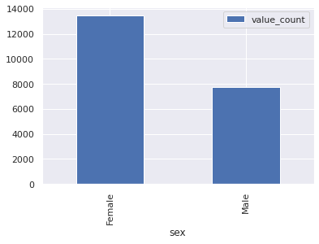
Occurrences by Gender
There are higher incidence of female patients that missed their appointments

Slide 8
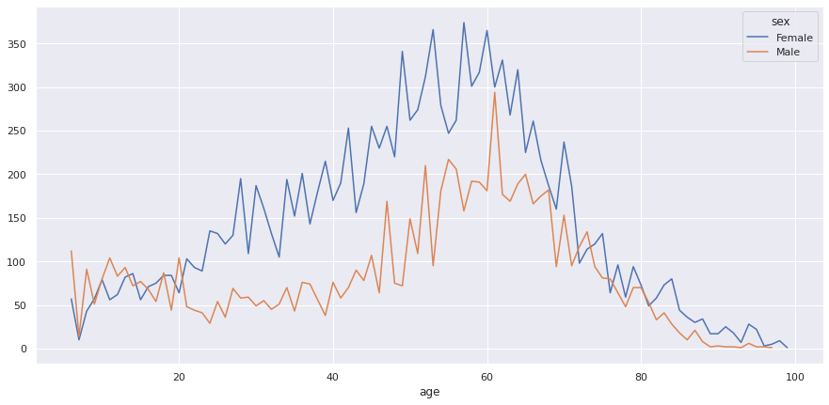
Occurrences by Gender and Age
Female patients missed more appointments than their male counterparts across age groups with some overlap on during under 20 age group.

Slide 9
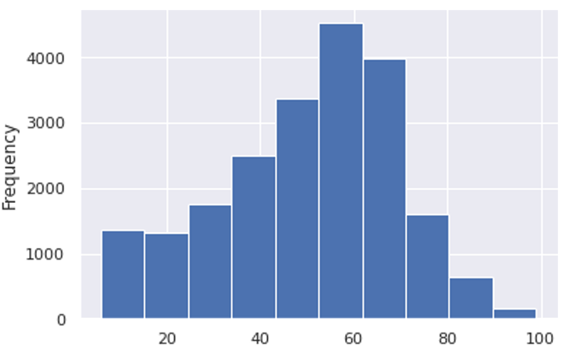
Age Distribution
Age distribution is left-skewed (negative skewness).
Minimum age = 1 | Maximum age= 99 | Mean age = 50.12 | Median age = 53

Slide 10
BASELINE ANALYSIS & FINDINGS using Tableau

Slide 11
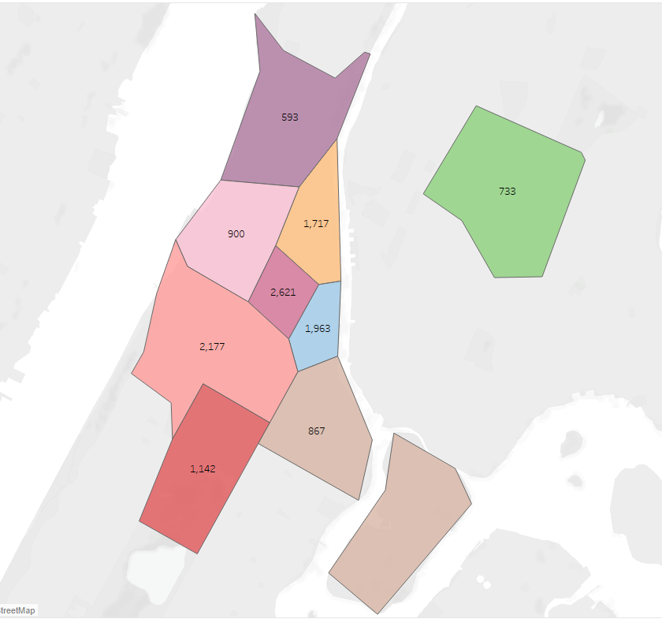
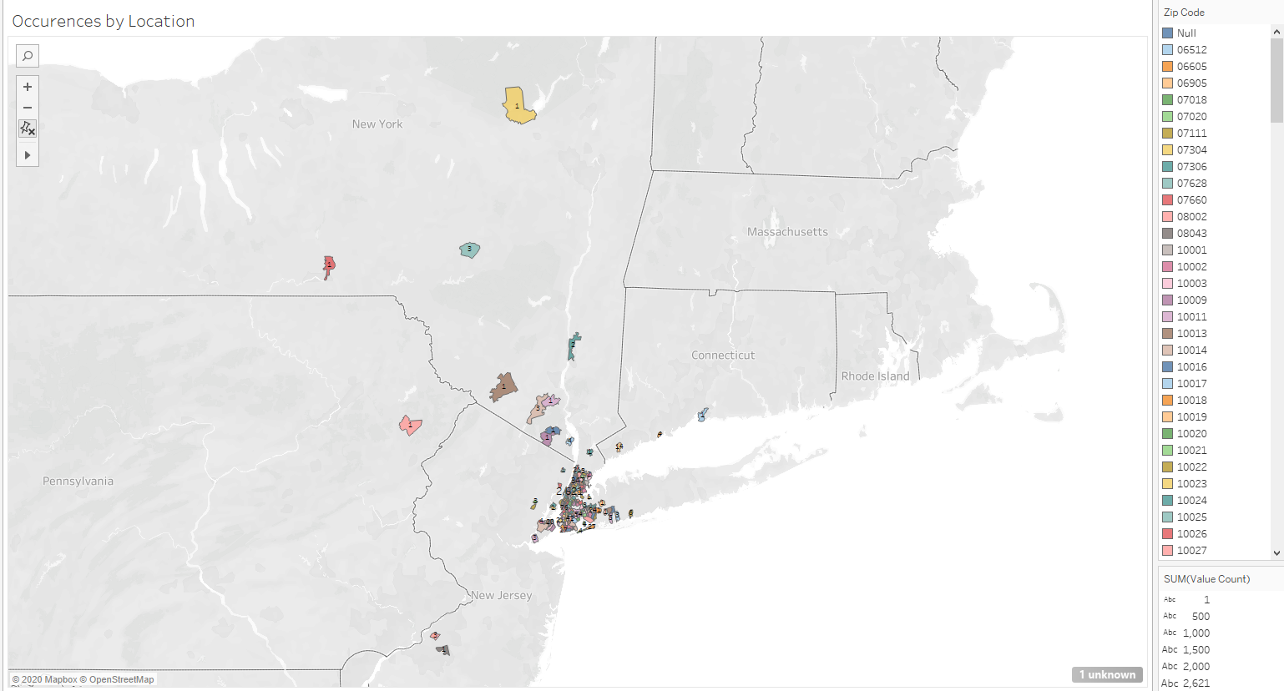

This map shows the states were our no-show patients are located.
PA, NY, NJ, CT
Majority of missed or no-show appointments were in Manhattan although these were the zip codes that had the greatest number of patients

Slide 12
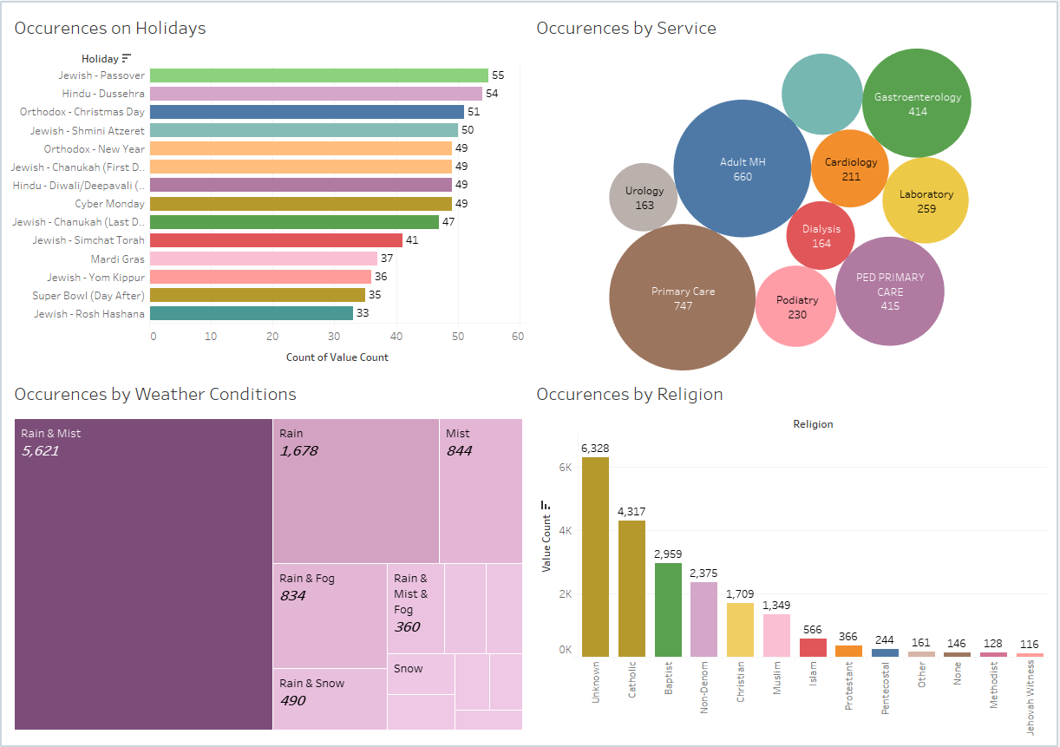

Slide 13
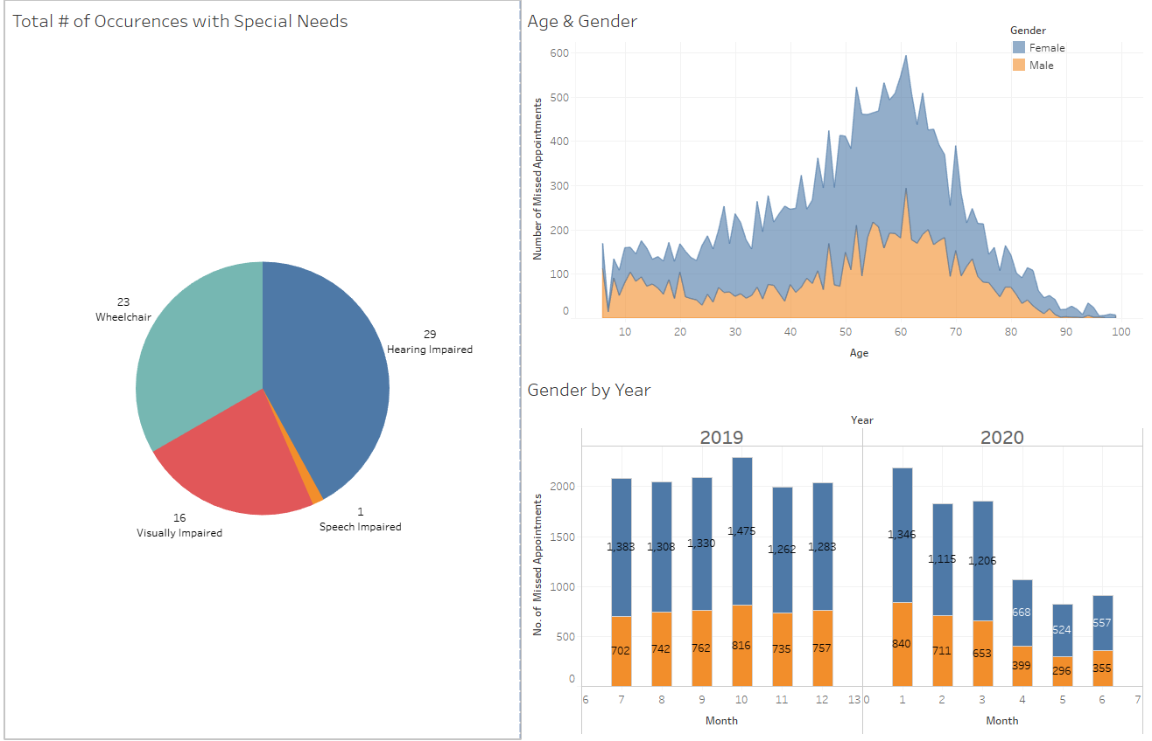

Slide 14
CONCLUSIVE ANALYSIS & FINDINGS using Tableau

Slide 15
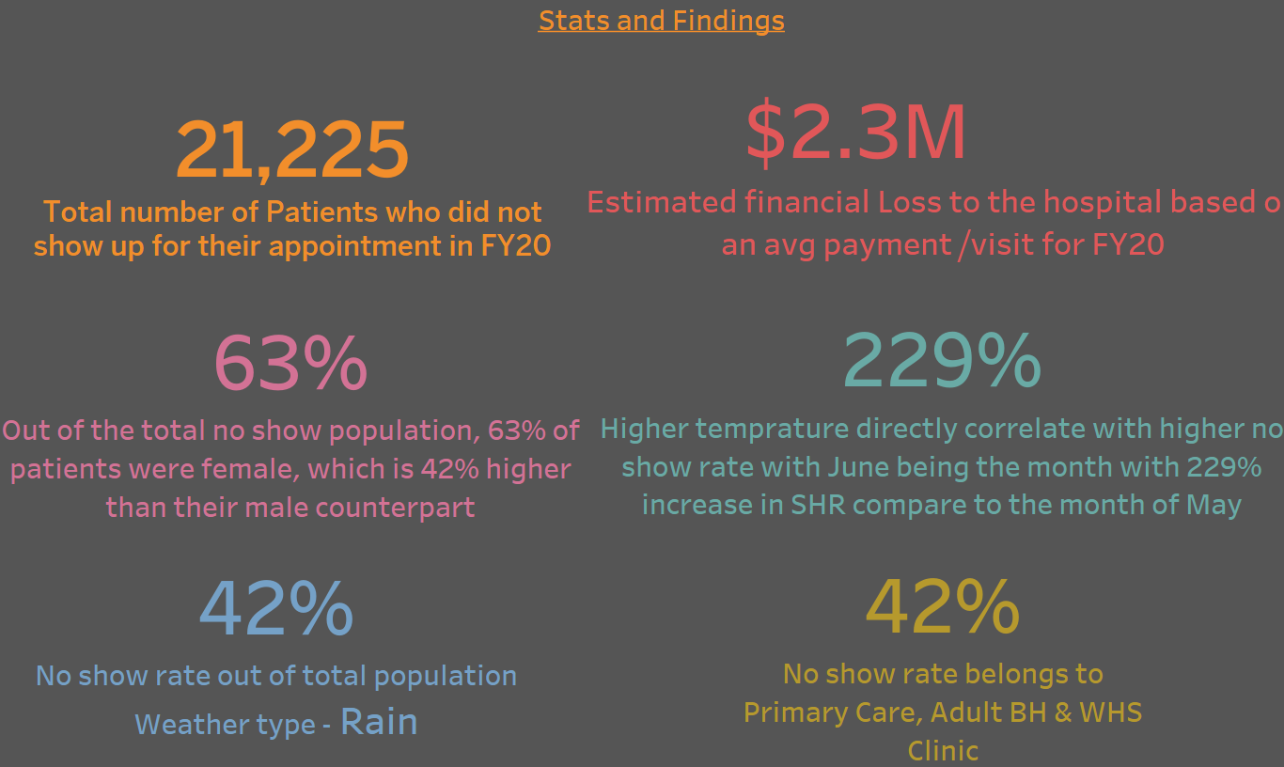

Slide 16
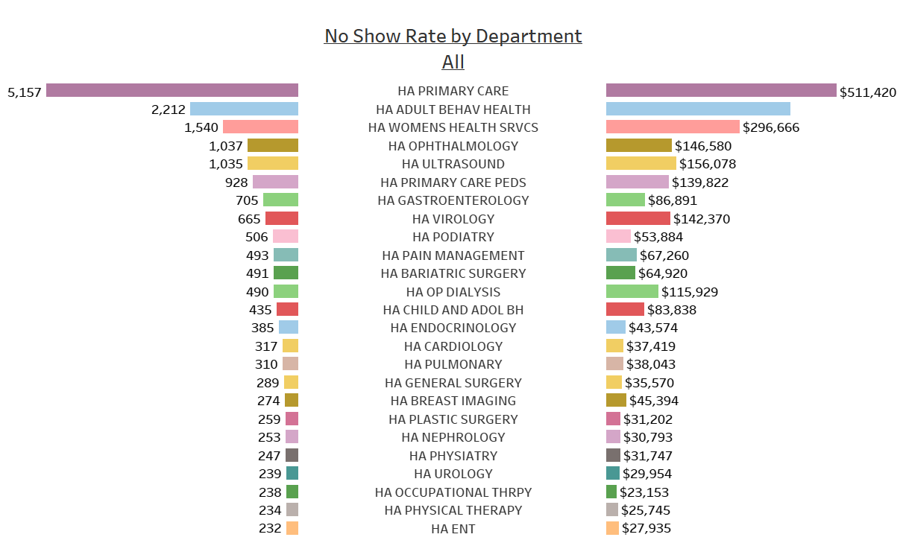
Financial Impact by Department
Primary Care, Adult BH, WHS and Ophthalmology dept accounted for more then 47% of the total No Show with the total lost revenue of $1.3M

Slide 17
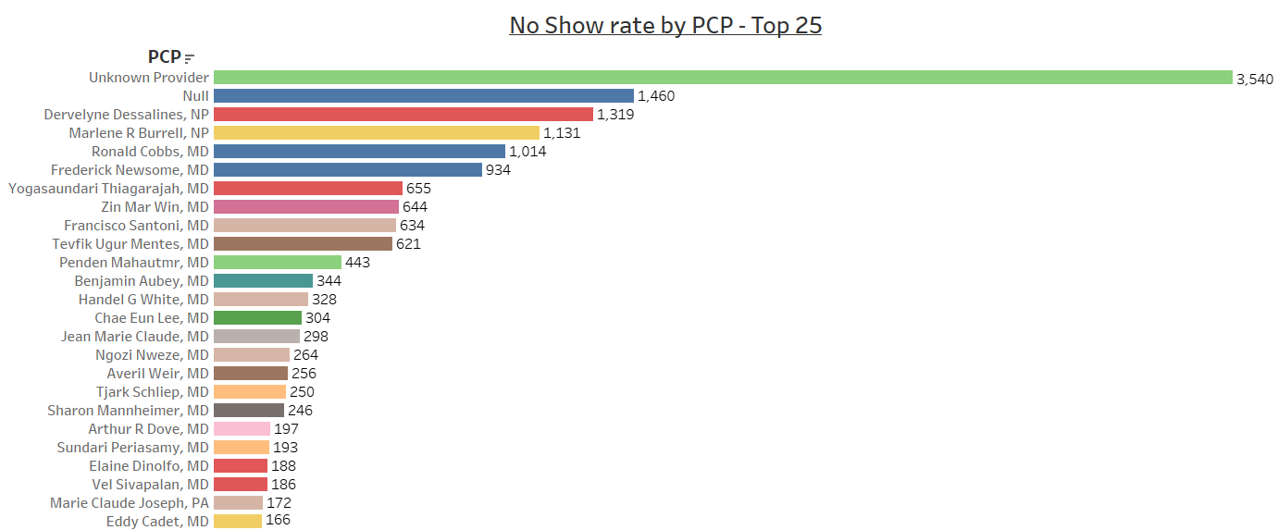
No Show Rate by PCP
24% of total no show patient has community-based PCP

Slide 18
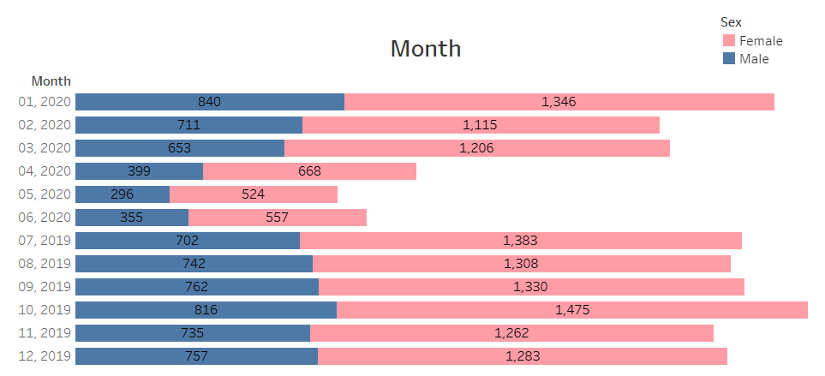
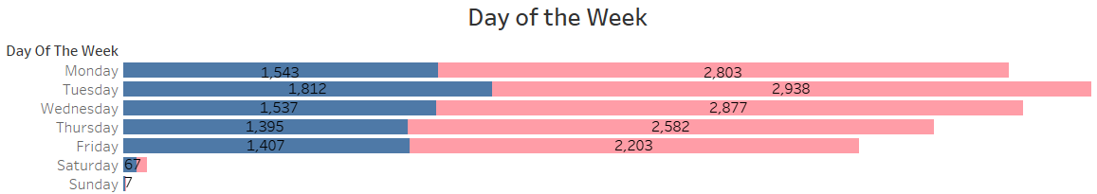
No-Show Rate by Month and Day of the Week
October recorded the highest NS for the fiscal year 2020
Tuesday seems to be the day of the week with the highest NS rate

Slide 19
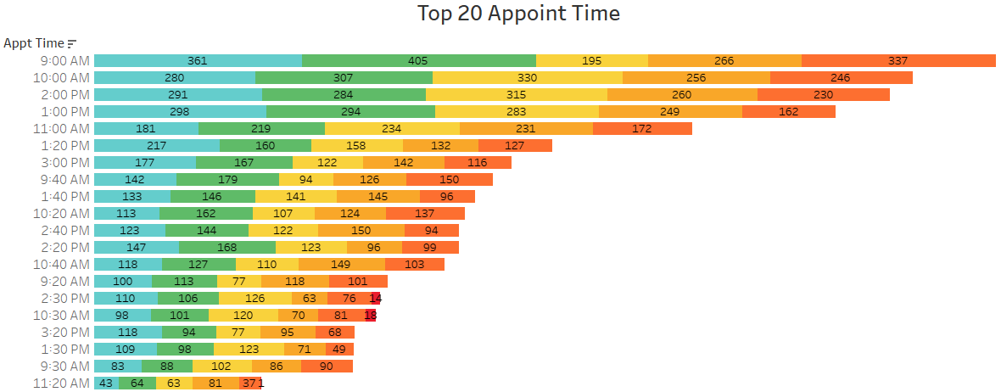
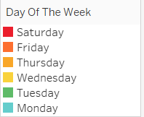
No-Show by Appointment Time – (Top 20 time slots)
9am appointments has the highest NS rate.
Tuesday had the highest NS rate among all the time slots

Slide 20
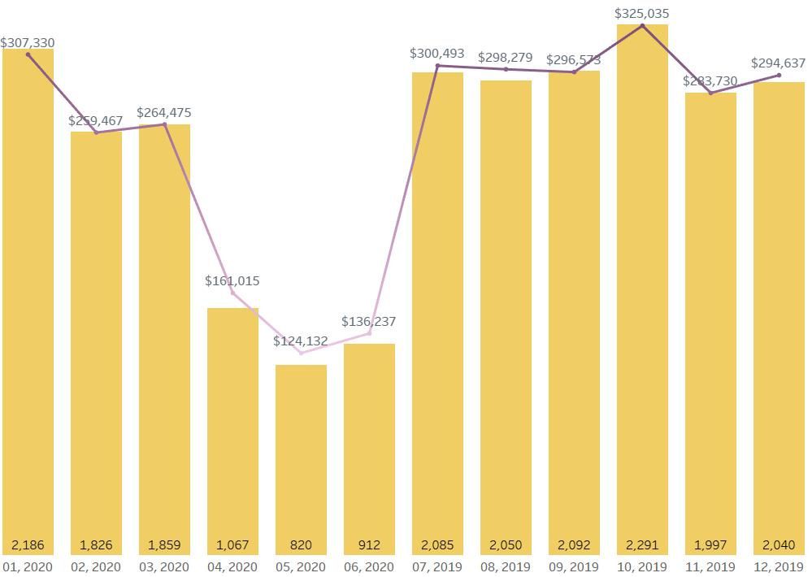
No-Show Rate by month and estimated lost revenue
There is a direct correlation between no show rate and lost revenue opportunity.
The month of October recorded the highest lost in revenue due to NS for the fiscal year 2020.

Slide 21
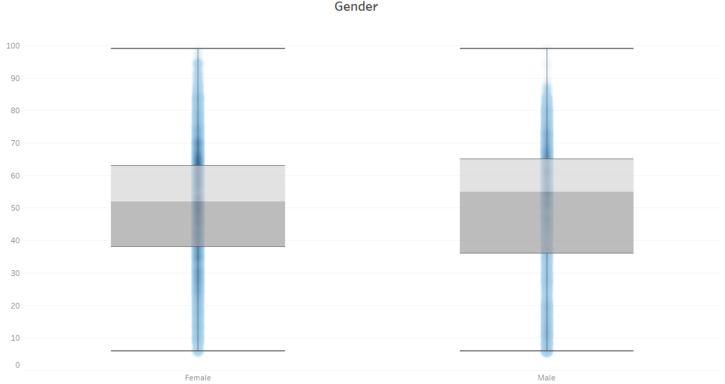
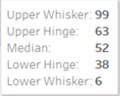
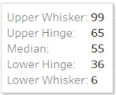
No Show Rate by Gender and Age
Median age of Male patients tend to be higher than female among the NS population

Slide 22
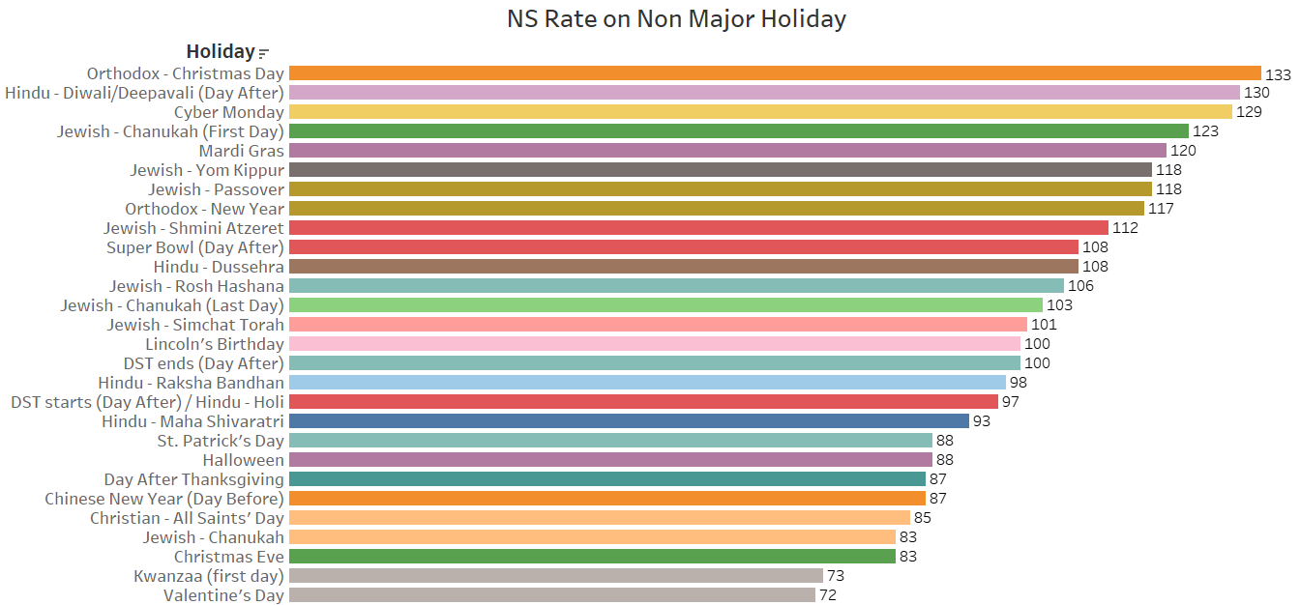
No Show Rate on Non-Major Holidays (>70)
Orthodox- Christmas, Diwali(Day After) and Cyber Monday topped the list
among the non major holiday with the highest NS rate.

Slide 23
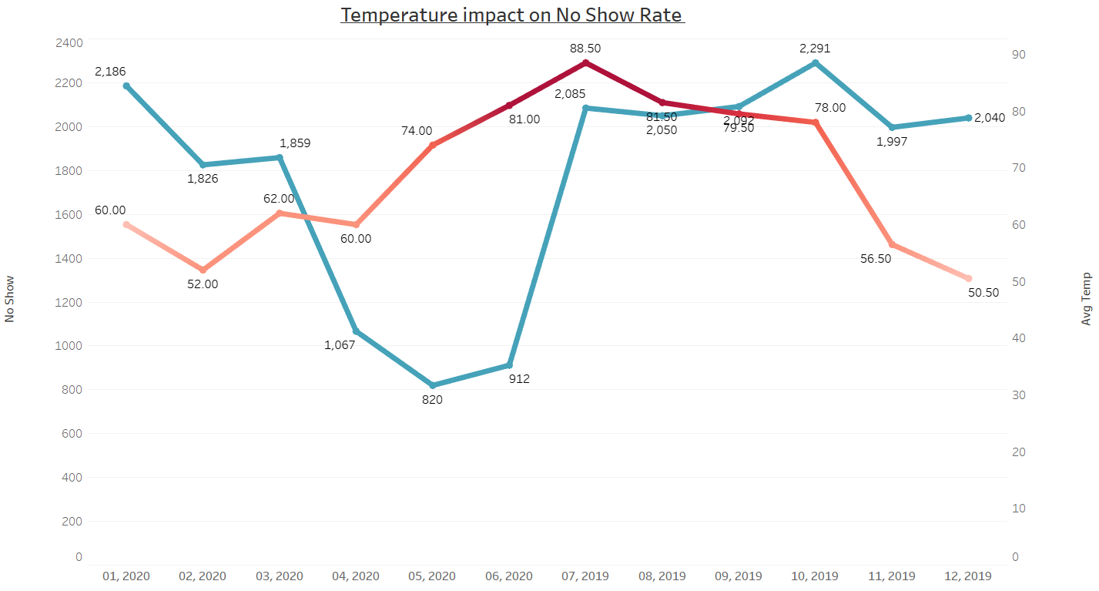
Temp Correlation with No-Show Rate
Higher temperature directly correlate with higher no-show rate with June being the month with 229% increase in NSR compare to the month of May

Slide 24
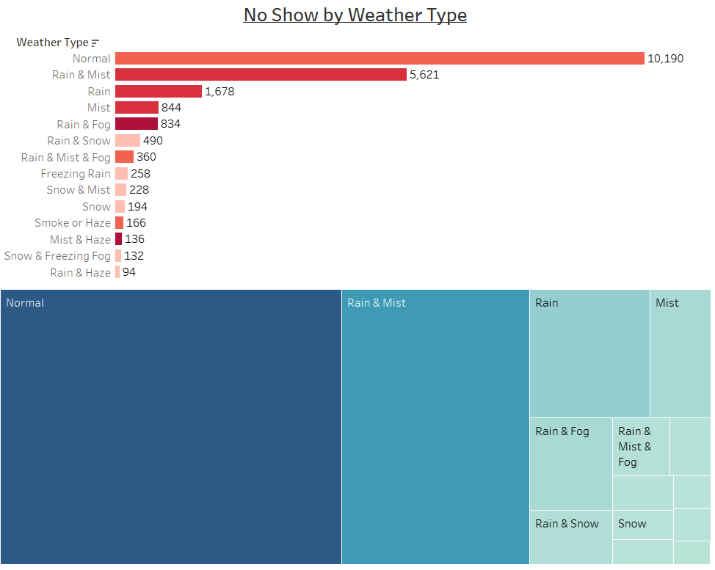
Weather Type Correlation with No Show Rate
42% of total no show days had weather type of rain associated with it

Slide 25
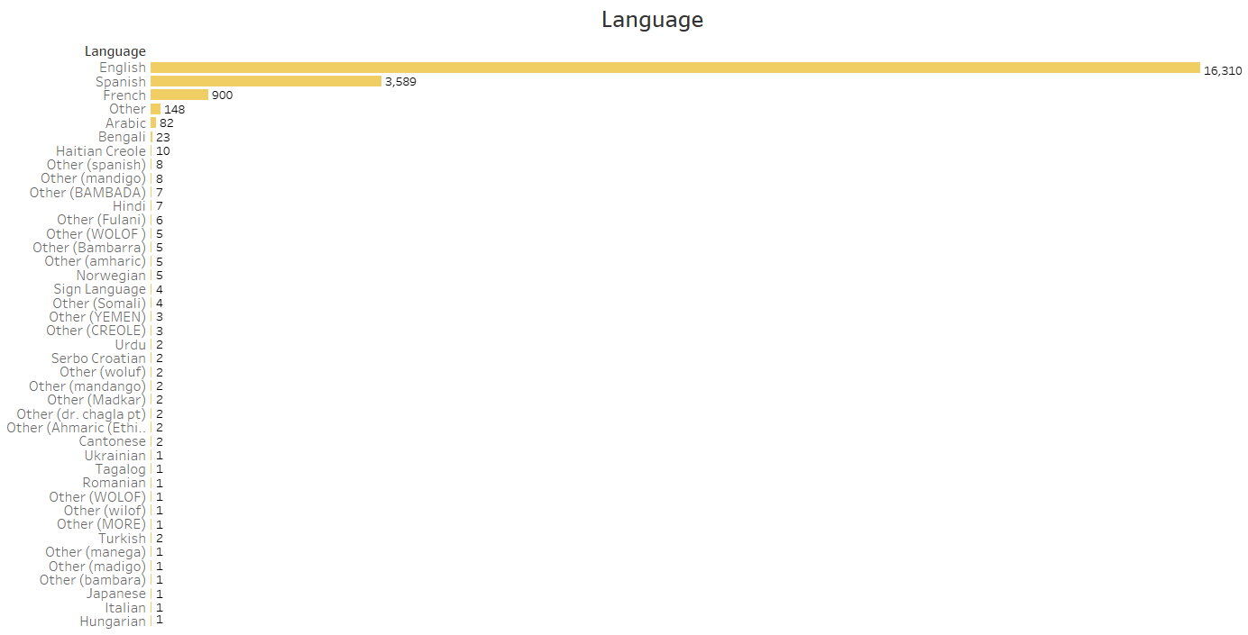
No Show rate – First Language
78% of the no show population has English listed as their first language followed by Spanish at 17%. These stats tells us about diversity granularity of Harlem community.

Slide 26
Conclusion
U.S Healthcare system loses over $150 billion dollars in revenue each year due to patients not showing up for their appointments.
No Show also impacts a hospital cost allocation in terms of scheduling staff.
No Show also impacts patient care. Missed appointment can lead to higher acuteness of illness and medical costs overall as patients with treatable illness postpone care until their condition becomes urgent (and ultimately costs more).
Harlem hospital alone lost an estimated $2.3 million dollars for the fiscal year 2020.
For the recently concluded FY, over 21k patients did not show up for their appointment.
Our analysis broke down the FY20 No show data set and gave us some very factual insight. Some of the key findings are:
Female patients no show rate is higher than their male counter part.
Higher Temperature and rainy weather are linked to higher no-show rate.
Patients between the age of 50-60 have the highest no-show rate.
Appointment time between 9am and 10am has the highest no-show rate.
Looking at weekdays, Tuesday tend to have the highest no-show rate through the year.

Slide 27
References
https://w2.weather.gov/climate/xmacis.php?wfo=okx
https://en.wikipedia.org/wiki/Public_holidays_in_the_United_States
https://www1.ncdc.noaa.gov/pub/data/cdo/documentation/LCD_documentation.pdf
https://www.ncdc.noaa.gov/cdo-web/datasets#LCD
https://www.timeanddate.com/holidays/us/2019
https://www.timeanddate.com/holidays/us/
https://www.ncdc.noaa.gov/cdo-web/datasets#LCD

Slide 28



Slide 29

Any
Questions?

